Slide 1
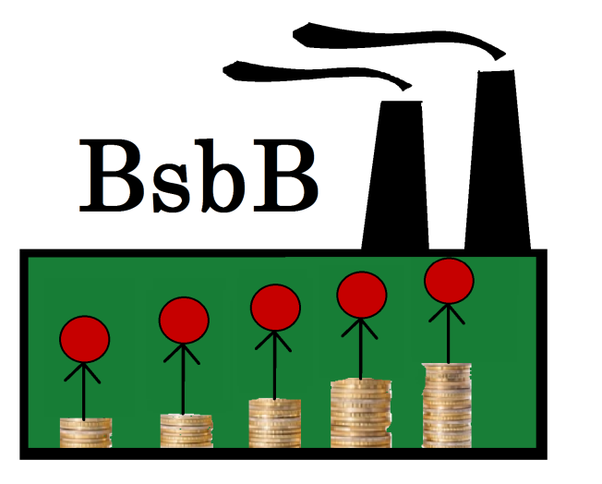
“Bangladeshis save for a better Bangladesh”
Sajida Khattabi Céline Méhault Sarah Stelzner

Slide 2
Table of contents
Macroeconomic context of Bangladesh
Supply of saving products
Our product
Conclusion and challenges

Slide 3
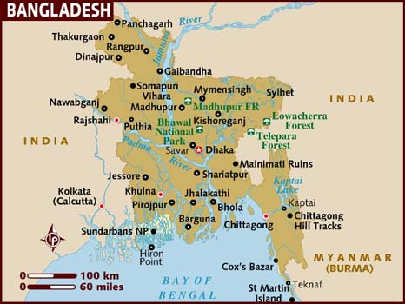
Macroeconomic context of Bangladesh
Population
166 millions
Median age : 24 years old
Economy
GDP grows by 6% each year
Clothing industry → 75% of Bangladesh‘s export earnings
2nd largest clothing exporting country
More than 6000 textile factories

Slide 4
Working conditions and wages
April 24, 2013:
collapse of Rana Plaza building
1135 workers died,
3000 others were injured
Other accidents :
Tazreen Fashions, Spectrum Garmen…

Slide 5
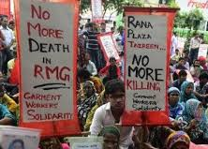
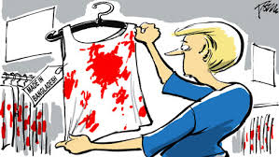
Working conditions don’t respond to international standards
Low wages :
between $70 and $100/month
Incidents (Rana Plaza…) raise questions
for firms, International organizations, and
western consumers awareness

Slide 6
Trend of savings in Bangladesh

Slide 7
Trend of savings in Bangladesh

Slide 8
Supply of saving products
There is no efficient saving product for the factory
workers of Bangladesh

Slide 9
Our product
- A microsaving product for factory workers in Bangladesh -

Slide 10
Target group
1) International companies which produce in Bangladesh
……………………………..

Slide 11
Target group
2) Factory worker of Bangladesh
„Parmin Hazari“: the worried sewer
Behavior
has worked in the factory for 7 years
sees her children 2 times a year
had money under the mattress -> was stolen
Demography
27 years old
wage: BDT 6.900
birthplace: Burimari
2 daughters, stay with their grandmother in
Burimari
Wishes and needs
visit her children (currently she can do it 2
times a year)
training to get a better position in the factory

Slide 12
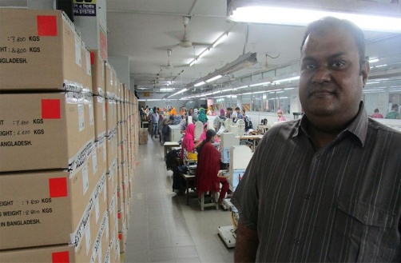
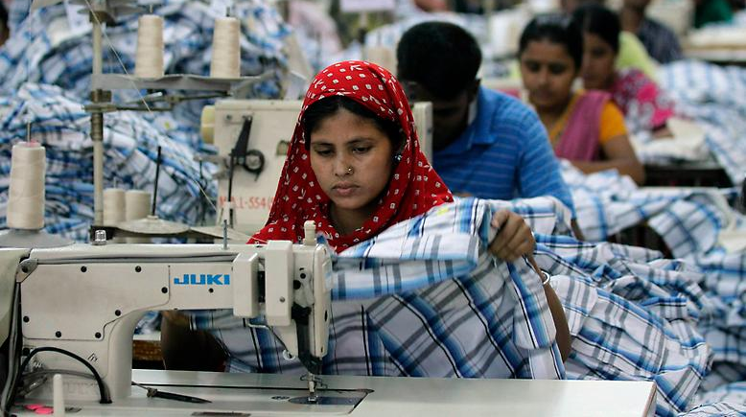
International companies
which produce in Bangladesh
Saving foundation
Factory owner
Worker
of the textile industry in Bangladesh

Slide 13
Factory owner
or a special saving agent
save micro part of the wage
Worker
of the textile industry in Bangladesh

Slide 14
Factory owner
or a special saving agent
save micro part of the wage
Worker
of the textile industry in Bangladesh
determines a fixed saving target

Slide 15
Factory owner
or a special saving agent
Saving foundation
send saving sum
save micro part of the wage
Worker
of the textile industry in Bangladesh
determines a fixed saving target

Slide 16
Factory owner
or a special saving agent
Saving foundation
send saving sum
save micro part of the wage
Management
Control
Investment
Worker
of the textile industry in Bangladesh
determines a fixed saving target

Slide 17
Factory owner
or a special saving agent
Saving foundation
send saving sum
save micro part of the wage
Management
Control
Investment
Worker
of the textile industry in Bangladesh
sustainable Projects in Bangladesh
determines a fixed saving target

Slide 18
International companies
which produce in Bangladesh
Factory owner
or a special saving agent
Saving foundation
send saving sum
save micro part of the wage
Management
Control
Investment
Worker
of the textile industry in Bangladesh
sustainable Projects in Bangladesh
determines a fixed saving target

Slide 19
International companies
which produce in Bangladesh
Factory owner
or a special saving agent
Saving foundation
send saving sum
save micro part of the wage
Management
Control
Investment
Worker
of the textile industry in Bangladesh
sustainable Projects in Bangladesh
determines a fixed saving target

Slide 20
International companies
which produce in Bangladesh
Factory owner
or a special saving agent
Saving foundation
send saving sum
outpayment with bonus
save micro part of the wage
Management
Control
Investment
Worker
of the textile industry in Bangladesh
sustainable Projects in Bangladesh
determines a fixed saving target

Slide 21
International companies
which produce in Bangladesh
Factory owner
or a special saving agent
Saving foundation
send saving sum
outpayment with bonus
save micro part of the wage
Management
Control
outpayment with bonus
Investment
Worker
of the textile industry in Bangladesh
sustainable Projects in Bangladesh
determines a fixed saving target

Slide 22
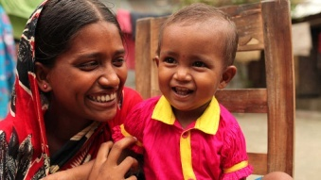
Bonussystem
for special sustainable targets
Saving target | additional benefits for the worker | additional benefits for the company | additional benefits for the factory owner
to pay the cost of a journey to the children / family | satisfaction social contact security | support of families | more content employees danger that workers move back to the country sinks
education for their children | better perspective for the future | support of education | improve Bangladesh as a location factor
advanced training for a better sewing | opportunity for promotion | better product quality | better certified worker
modernisation (e. g. a better cooking place or bath place for the living community) | improvement of living conditions | support the local communities | happier employees

Slide 23
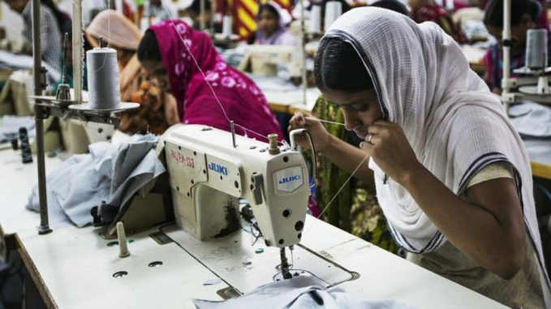
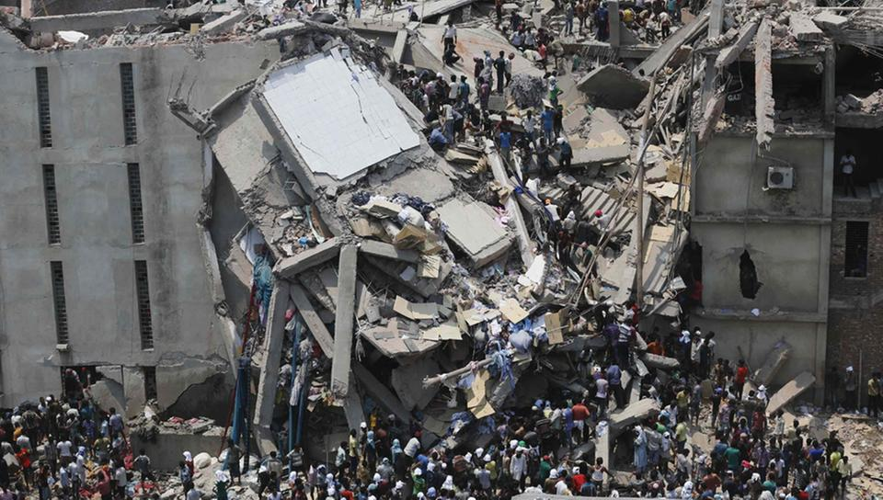
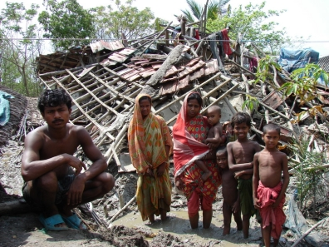
Bonussystem
for good work
if the worker gets on a better sewing level
shock
industrial accident
natural disaster
-> so we also have an insurance function in our product!

Slide 24
Benefits
International companies
+ reputation
+ corporate social responsibility (CSR)
+ transport enterprise value
+ proactive management
Factory owner
+ more motivated workers
Worker
of the textile industry in Bangladesh
+ possibility to save money
+ protection for the future
+ indirect pay increase
+ better living conditions (sustainable projects in Bangladesh)

Slide 25
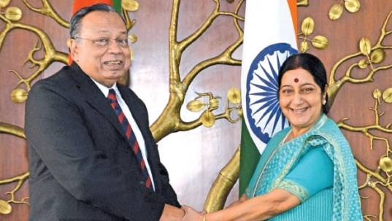
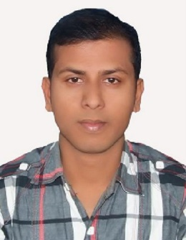
Cognitive biases
Loss aversion effect
Saving agent
Marketing strategies (notes, posters,…)
2) Status quo bias
Gift for the first 100 savers
Picture: “saver of the month“

Slide 26
Challenges and Conclusion
With the help of BsbB Bangladeshis get the possibility to save money efficiently and safely
So they can fullfill their dreams
Even the other parts have benefits
BUT: Are the companies prepared to support such a project?

Slide 28
Answers
„Very interesting concept!“
We are interested in social initiatives!
Safety: What happens if the investments get lost?
“All in all I think your project is really good!”
We’d have to wait for the digitization of wages before starting up a project like yours.

Slide 29
Thank you for your attention!

Slide 30
appendix

Slide 31
Saving Formular
S = savingpart
L = wage
H = household members
Z = number of saving targets
Parmin Hazari hat einen Monatslohn von BDT 6.900. Für das Geld muss sie sich und ihre 2 Kinder versorgen. Als Sparziel hat sie das Busticket zu ihren Kindern, welches BDT 1.600 (≈ 18 Euro) kostet.
Von ihrem Monatslohn spart sie monatlich also BDT 412,33 (= 4,66 Euro).
Insgesamt spart sie für ihr Sparziel BDT 1.320 und erhält BDT 280 als Bonuszahlung. Das entspricht einer Rendite von über 21 % (ohne Zeitfaktor).
Sparsumme insg. | BDT 1.320 (= 14,92 Euro)
Bonuszahlungen - Sparziel aus Liste - Levelaufstieg | BDT 150 BDT 130 => Bonus insg. BDT 280 (=3,08 Euro)
Summe | BDT 1.600 (= 18 Euro)

Slide 32
Langfristige Perspektive
Bei 5.000 Textilfabriken mit rund 4,5 Millionen Arbeiterinnen ergibt sich für die Saving Foundation eine potentielle Sparsumme von 18 Millionen Euro monatlich (bei einer durchschnittlichen Sparsumme von 4 Euro). Diese legt sie in nachhaltigen Projekten in Bangladesch und traditionelle Renditeprodukte an, um ihre Verwaltungskosten zu tragen und die Liquidität zu sichern.

Slide 33
Mail of Ernsting‘s family
Gesendet: Freitag, 24. Juni 2016 um 16:18 Uhr Von: "Stephan Harms" <Stephan.Harms@ernstings-family.com> An: "Sarah Stelzner" <S-Stelzner@web.de> Betreff: WG: Fwd: Bitte um Einschätzung meiner studentischen Sparidee BsbB
Sehr geehrte Frau Stelzner, Herr Concilio hat mir Ihre Seminararbeit zugesandt. Mein Name ist Stephan Harms und ich bin Leiter der Abteilung Beschaffungskoordination & Nachhaltigkeit. Wie Sie vermutlich wissen engagiert sich Ernsting's family intensiv in den Beschaffungsmärkten, darunter natürlich auch Bangladesch, im Rahmen von Initiativen wie die Business Social Compliance Initiative, der Accord on Fire and Building Safety in Bangladesh und die Carbon Performance Improvement Initiative, um die Einhaltung von Arbeitsstandards und eine ökologisch verträgliche Produktion unserer Ware zu ermöglichen. Hier befinden wir uns stets in unserer Einflusssphäre und begrüßen das soziale Engagement unserer Lieferanten. Ihr Konzept klingt sehr interessant. Sie umreißen sehr gut den makroökonomischen Kontext und den Marktüberblick. Eine intensivere Ausarbeitung des Kapitels 3.2.4. würde ich empfehlen, um das Konzept genauer zu erklären. Hier bleiben einige Fragen offen, wie zum Beispiel: "Wie wird die Sicherheit des Kapitaleinsatzes gewährleistet, wenn in lokale Nachhaltigkeitsprojekte investiert wird? Was passiert, wenn die Investitionen verloren gehen?" Ich hoffe, dass ich Ihnen weiterhelfen konnte und wünsche Ihnen viel Erfolg bei der Präsentation am kommenden Mittwoch. Mit freundlichen Grüßen / best regards Stephan Harms Beschaffungskoordination & Nachhaltigkeit Ernsting's family GmbH & Co. KG Hugo-Ernsting-Platz 1 D-48653 Coesfeld-Lette Germany

Slide 34
Mail of Bestseller
Dear Sarah,
Wages and management systems are essential topics on the sustainability agenda at present. BESTSELLER does not own any factories, but we work in close cooperation with our suppliers on improving the conditions for the factory workers and ensuring that they are paid a fair and decent wage and have the ability to save up money for future investments and unforeseen expenses. However, it takes a lot of time and efforts to change the behavior and procedures in countries like Bangladesh where payments are not even digitalized. We know for a fact that in some large factories it takes approx. a week to pay the wages every month due to the manual handling.
The idea of involving the factory management in the savings project is in theory good, but we must be aware that this in many cases will require more work to the management and possibly also extra fees for handling the task. Another thing is that the workers will be reluctant towards investing money as this is not habit in their countries. So for the project to succeed on this part, you’d have to spend many resources on raising their awareness and level of knowledge about the advantages of investing the money. Finally, the workers already save up a little amount of money, and in some countries they send the money to their families in the villages where they come from every month. You must be aware that in some countries the minimum wages are still quite low, so really there isn’t much to save up from.
All in all I think your project is really good, and maybe it could be a possibility in some countries, but in regards to most of our suppliers (supplier countries) we’d have to wait for the digitization of wages before starting up a project like yours.
I’d recommend you to talk to Business for Sustainable Business (BSR). They’re right now trying to roll out a Wage Digitization project in Bangladesh, and they can tell you more about the challenges they’re facing in the country when it comes to payment of wages and saving up money.
Good luck with your project.
Best regards
ANJA BREMHOLM NIELSEN
CORPORATE SUSTAINABILITY / CSR SPECIALIST
P
+4599421570
M
+4552151570
E
ANJA.BREMHOLM@BESTSELLER.COM
W
BESTSELLER.COM
BESTSELLER A/S
INGE LEHMANNS GADE 2, 8000 AARHUS C
DENMARK

